Slide 1
Traffic Cone Segmentation
David Korčák, Roman Šíp

Slide 2

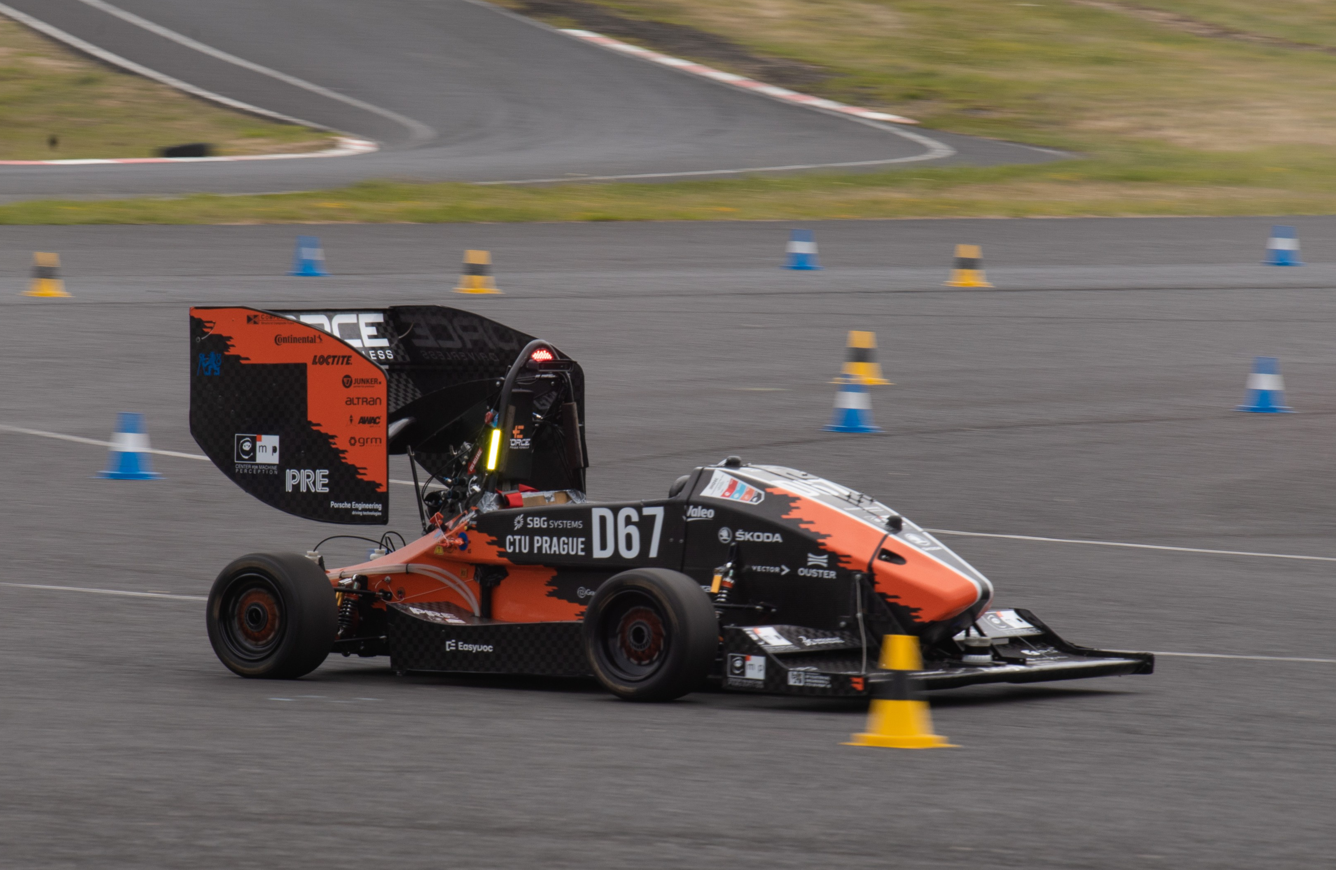
The problem
We are members of the autonomous group at eForce Prague Formula
Development of self-driving electric car
Perception with an RGB camera

Slide 3
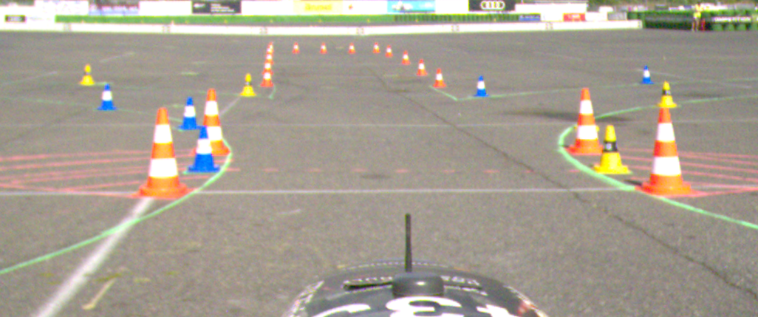
The problem
Key landmark for navigating the car - colored traffic cones
Cones follow certain rules:
Blue - left
Yellow - right
Orange - exit zones
Big Orange (with two white stripes) - start/finish line

Slide 4
The problem
Currently: object detection (YoloV8-small) + homography projection
Requires manual (re)calibration of the camera to find the homography matrix
Sensitive to shaking, disturbances
New idea: Find the pixels of the cone in the image, estimate corners of it’s base and using known dimensions of the cone, estimate it’s 2D coordinates on the ground plane
Noisy detections
We need segmentation of the cone

Slide 5
Dataset
Publicly available dataset FSOCO https://www.fsoco-dataset.com/
Camera images labelled and collected by different teams
1516 images with full (instance) segmentation masks

Slide 6
Analysis of the dataset
big issue !

Slide 7
Analysis of the dataset

